Slide 1
ROAD TRAFFIC ANALYTICS
Transportation Accident
Dashboard Report
A visual walkthrough of accident severity, hotspots, causes, risk and response-performance analytics
Prepared by Rhutuja | Power BI Report

Slide 2
AGENDA
What we'll cover
01
Accident Severity Overview
05
Incident Response Performance
Dashboard 1 of 7
Dashboard 5 of 7
02
Incident Hotspot Intelligence
06
Response Priority
Dashboard 2 of 7
Dashboard 6 of 7
03
Temporal & Causal Hotspots
07
Operational Coverage
Dashboard 3 of 7
Dashboard 7 of 7
04
Environmental & Road Risk
Dashboard 4 of 7

Slide 3
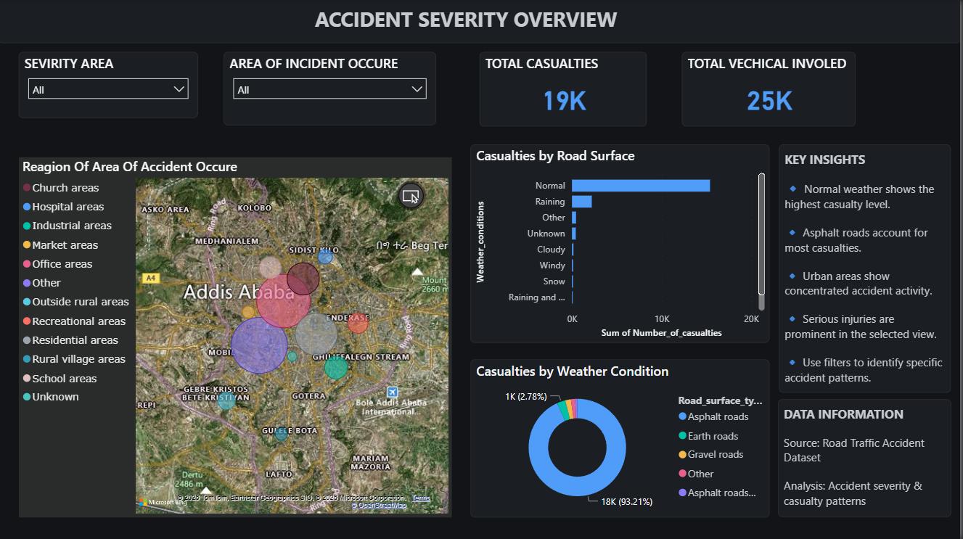

Slide 4
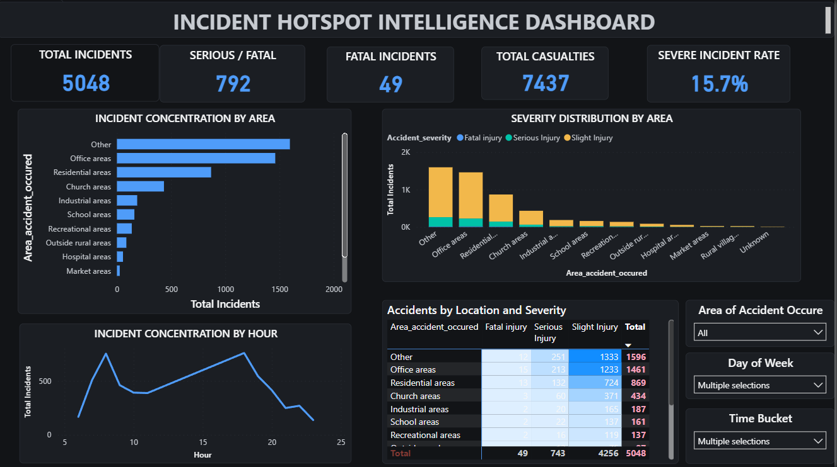

Slide 5
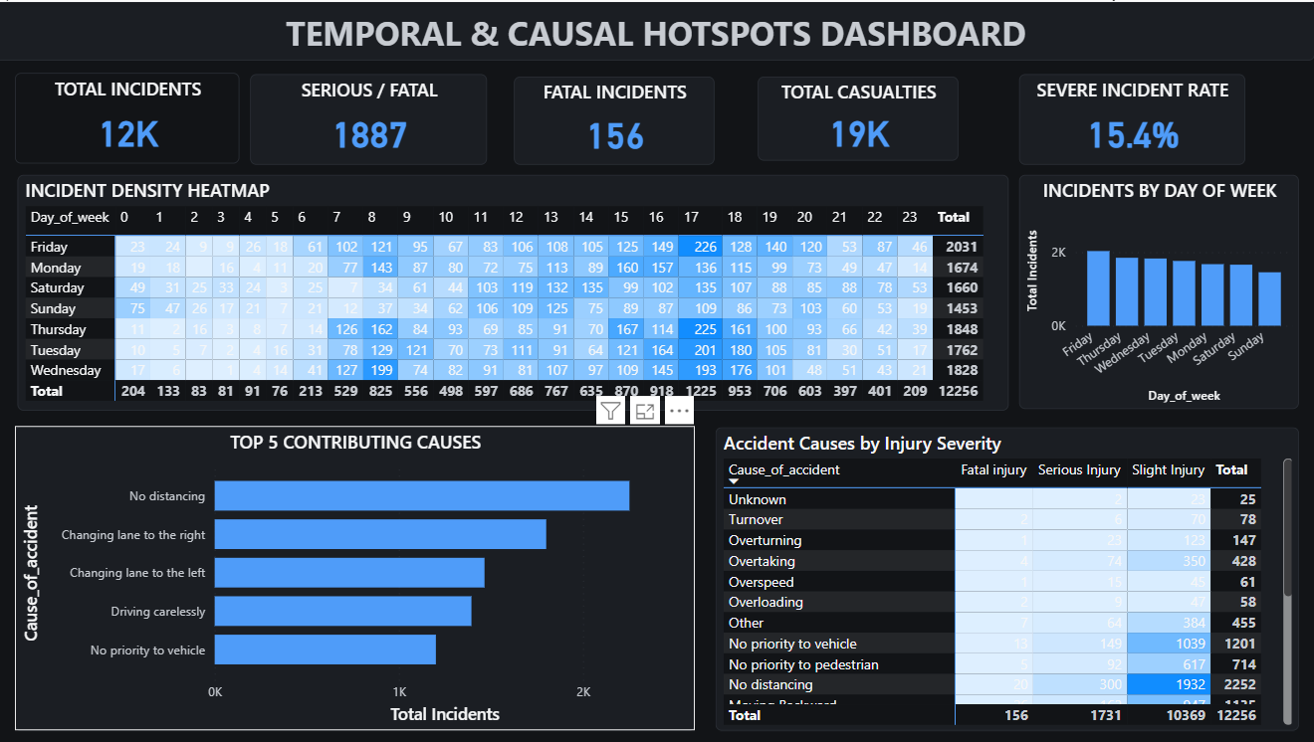

Slide 6
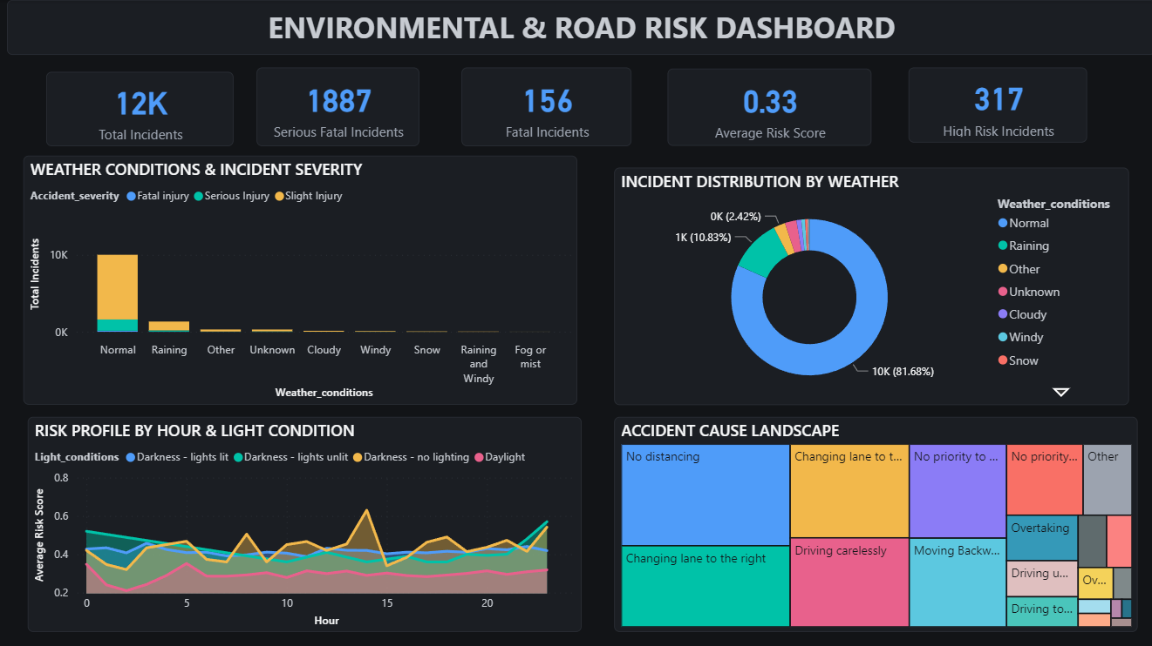

Slide 7
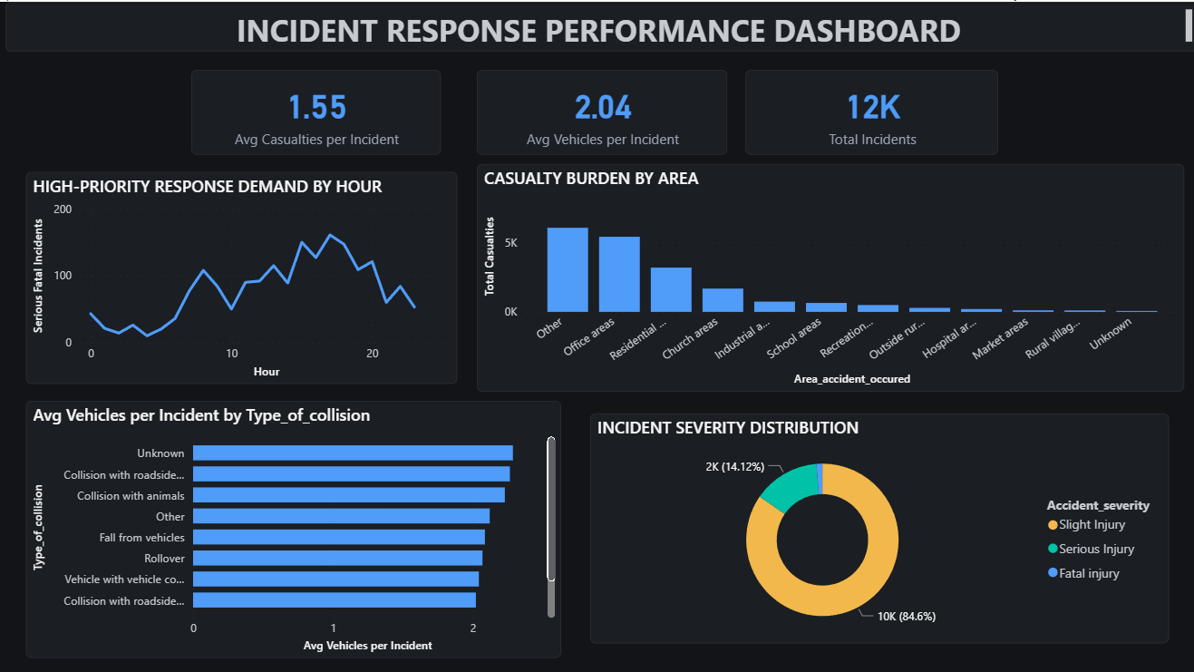

Slide 8
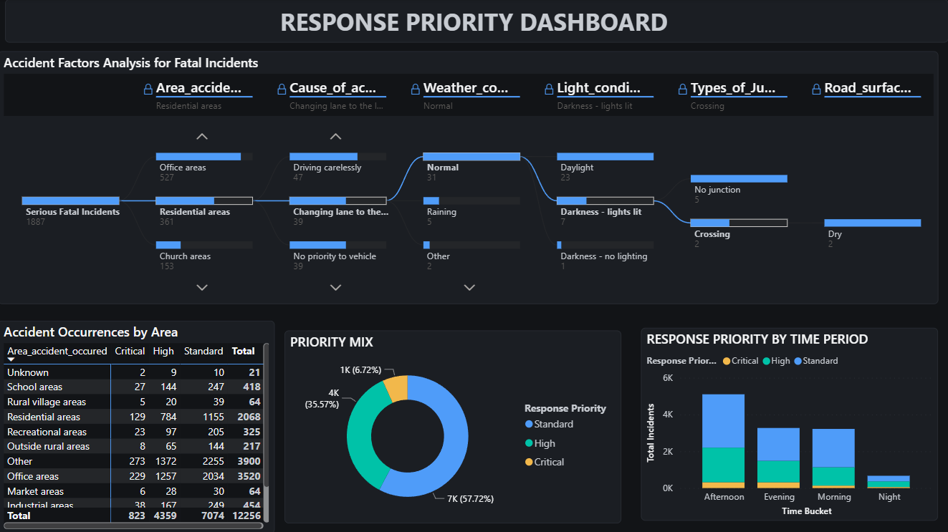

Slide 9
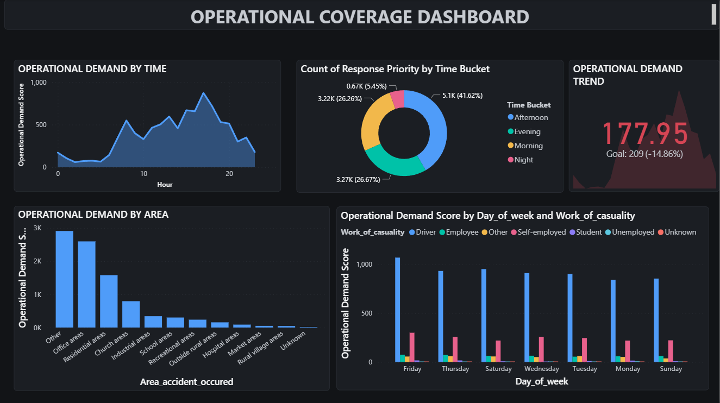

Slide 10
CONCLUSION
Key takeaways
12K
19K
156
15.4%
Total Incidents
Total Casualties
Fatal Incidents
Severe Incident Rate
Normal weather and asphalt roads account for the overwhelming majority of casualties — conditions alone don't explain severity.
Incidents concentrate heavily in "Other" and Office-area zones, and spike in the 15:00–18:00 afternoon window.
No distancing, unsafe lane changes, and careless driving are the leading contributing causes across fatal and serious incidents.
57.7% of incidents are Standard priority, but Critical/High-priority cases cluster in Residential and Office areas — a clear target for response planning.

Slide 11
Thank You
Questions & discussion welcome

